Slide 1

Congestion Quarantine in Lossless Ethernet
Dongkang Hu¹, Ran Shu², Wenxue Cheng², Fengyuan Ren¹
¹ Tsinghua University ² Microsoft Research Asia
Notes:
Hello everyone. Today I will present Congestion Quarantine in Lossless Ethernet. The core idea is simple: when congestion appears, do not let congested packets and normal packets wait in the same PFC queue. Quarantine the congested packets first, so healthy traffic is not infected by backpressure.

Slide 2
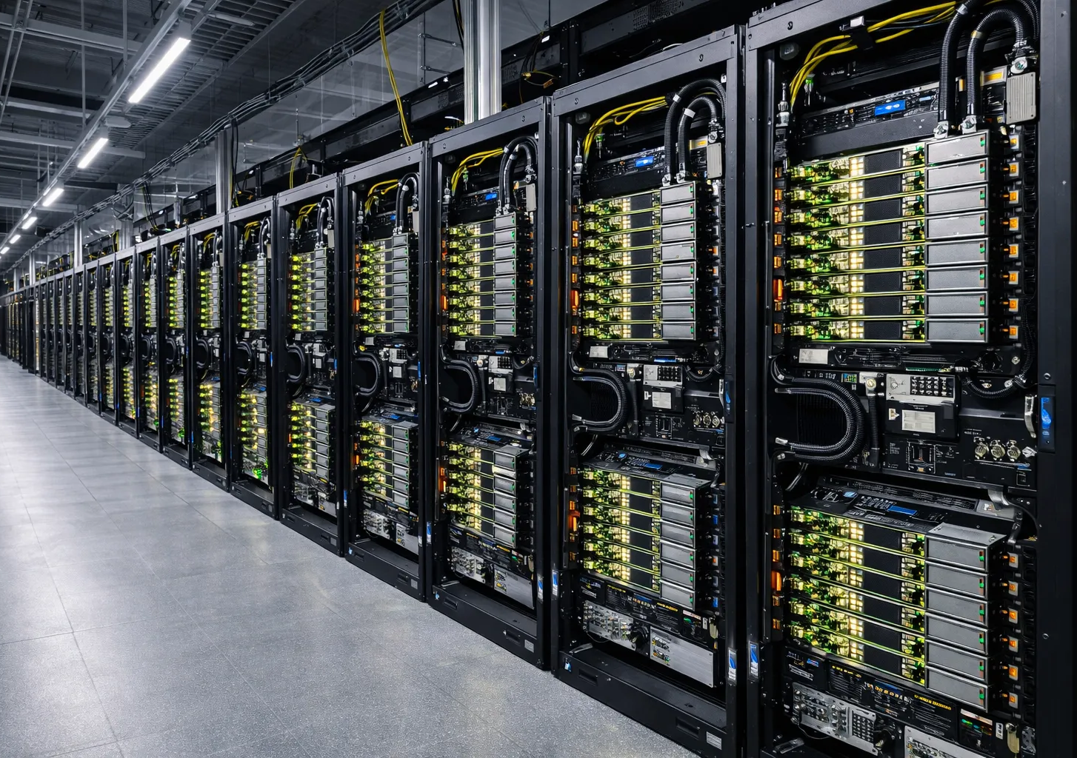
BACKGROUND —— Lossless is important in Clusters
Why this matters
RDMA over Converged Ethernet(RoCE) is the standard transport for both clouds and AI clusters.
Lossless configurations remain dominant because packet loss hurts RDMA performance.
PFC keeps packets from being dropped, but it does not remove congestion.
2
Notes:
RoCE is worth studying because modern cloud and AI clusters use RDMA-style transports for high throughput and low latency. RDMA over Converged Ethernet, or RoCE, moves transport work into the NIC and runs over Ethernet. The key point for this talk is not just that RoCE is fast; it is that preserving RoCE performance usually requires a carefully engineered lossless Ethernet fabric.

Slide 3
BACKGROUND
BACKGROUND——Lossless makes congestion complex
FC path
CC branch
RoCE requires lossless delivery
CC adjusts sender rates
PFC pauses upstream queues
But it cannot transmit through a paused queue
Packets are not dropped
Queue-level backpressure couples unrelated traffic
Paused queue
pause
HOL blocking and congestion spreading
Losslessness solves packet drops, but not congestion 、
3
Notes:
Now I separate the roles of flow control and congestion control. RoCE needs lossless delivery. Flow control, such as PFC or CBFC, pauses upstream queues so packets are not dropped. But the pause is at queue granularity, so unrelated traffic can inherit the same pause state. Congestion control changes sender rates, but it cannot transmit packets through a queue that is already paused. So losslessness solves drops, but not congestion isolation.

Slide 4
DESIGN
Congestion Point (CP)
classifier
SZ
packets →
egress
queue
detector
length > Eq
QZ
← release
RR scheduler serves both zones
quarantine / release notification
1 Monitor CP egress queues
2 Trigger if length > Eq
3 QP moves matches into QZ
4 Release if length < Er
Simulation thresholds in the paper: Eq = 200 KB, Er = 100 KB.
Hu et al., Congestion Quarantine in Lossless Ethernet, APNet ’26: Fig. 4 and §3 Congestion Quarantine.
APNet ’26 • Congestion Quarantine
Notes:
CQ has two roles. The congestion point monitors its egress queues and makes the quarantine decision. The upstream quarantine point receives the decision and moves matching packets into QZ. Safe packets remain in SZ. CQ uses round-robin scheduling between zones, so quarantined traffic still receives service.

Slide 5
BACKGROUND
The missing piece is congestion isolation
PFC pauses an upstream queue
Sick and healthy packets are mixed
CC adjusts sending rates, but it cannot transmit through a PFC-paused queue.
The pause state is inherited by all packets in the queue
Observed pathologies
Congestion
contagion
CC
dilemma
CC sidelined
by FC
Deadlock
risk
This talk focuses on the first three behaviors observed in the paper’s simple experiment.
Hu et al., Congestion Quarantine in Lossless Ethernet, APNet ’26: §2 Pathological Analysis.
APNet ’26 • Congestion Quarantine
Notes:
The key problem is not packet loss anymore. PFC prevents drops, but queue-level backpressure creates a shared pause domain. All packets in the paused queue inherit the same state, even if only some packets are responsible for downstream congestion.

Slide 6
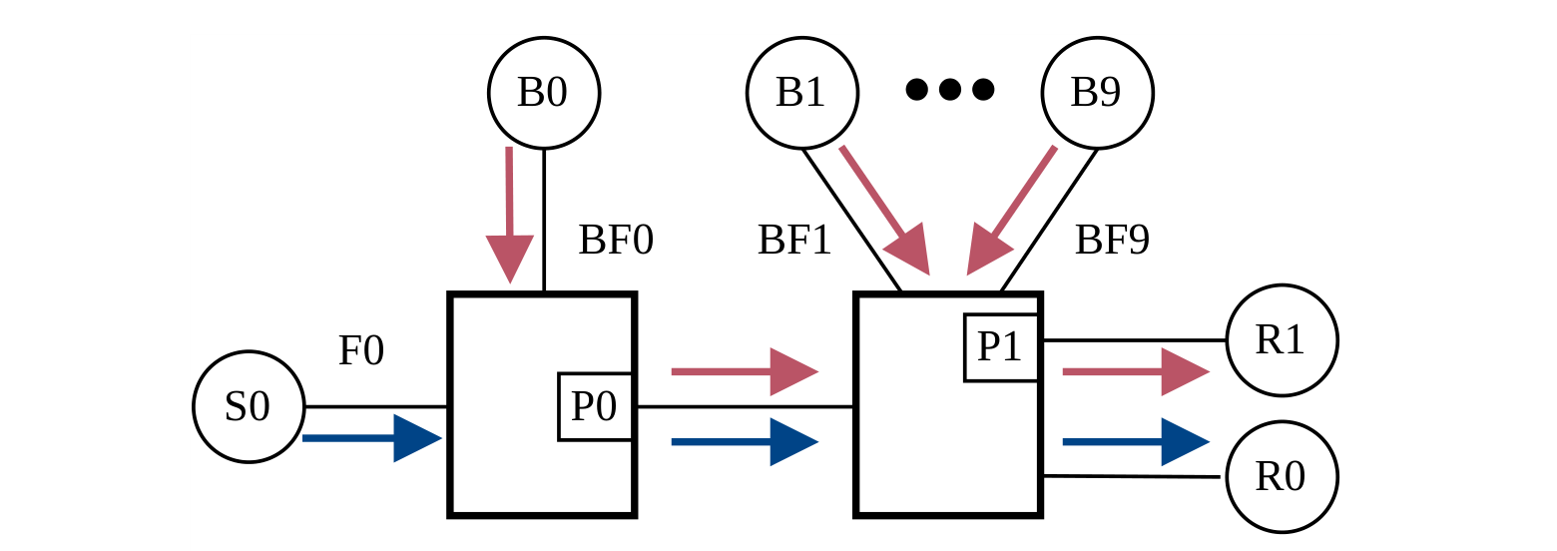
MOTIVATION
A simple experiment
Traffic input
Sick flows BF0–BF9: incast bursts to R1
Healthy flow F0: a long-lived flow to R0
Protocols compared
PFC-only, DCQCN, TIMELY, HPCC,
DCQCN-TCD, and ACC.
Healthy F0 shares P0 with sick BF0 and is infected into sickness.
Notes:
This is the motivation experiment. The red burst flows go to R1 and congest P1. The blue flow F0 goes to R0, so F0 is not the cause of the P1 congestion. However, F0 shares the upstream queue P0 with BF0. This makes F0 a victim flow under PFC.

Slide 7
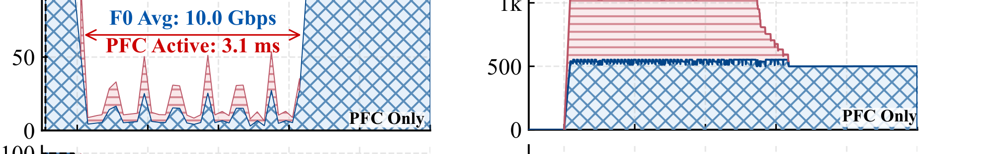
MOTIVATION
Pathology 1: PFC couples burst and innocent flows
Queue-level pause: BF0 and F0 inherit the same PFC state at P0.
Even though F0 does not pass through the congested egress P1, its packets are stored in the same upstream queue as BF0.
PFC active interval appears at the same time as F0 packet buildup in the shared queue.
Hu et al., Congestion Quarantine in Lossless Ethernet, APNet ’26: Fig. 2 and §2.1 “Congestion contagion”.
APNet ’26 • Congestion Quarantine
Notes:
The first pathology is congestion contagion. PFC is triggered by the downstream incast, but the pause is applied at queue granularity. Since BF0 and F0 share P0, F0 inherits the pause state. The row from Figure 2 shows the PFC active interval and F0 queue buildup at P0.

Slide 8
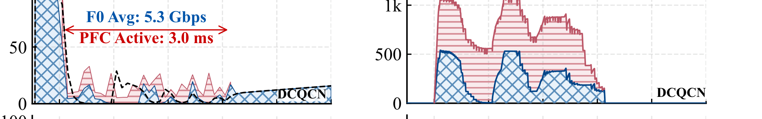
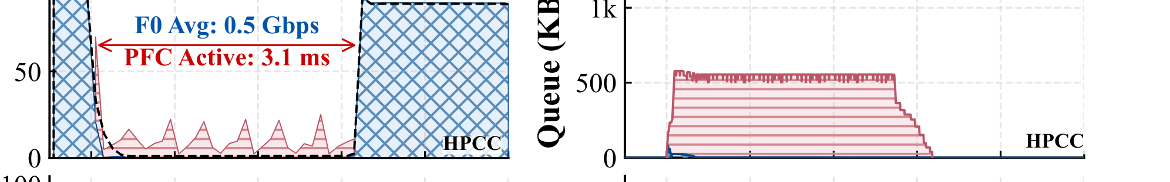
MOTIVATION
Pathology 2: CC has no good operating point under PFC
Mild CC: DCQCN
Keeps F0 from starving, but leaves larger queue buildup and spreading.
Aggressive CC: HPCC
Rate tuning alone cannot both control spreading and protect the victim flow.
Hu et al., Congestion Quarantine in Lossless Ethernet, APNet ’26: Fig. 2 and §2.1 “Congestion control dilemma”.
APNet ’26 • Congestion Quarantine
Notes:
The second pathology is the CC dilemma. Aggressive algorithms such as HPCC or TIMELY reduce queue buildup, but they also reduce the victim flow rate severely. Milder algorithms such as DCQCN preserve more victim throughput, but allow more queue buildup. Under PFC, no rate choice gets both properties.

Slide 9
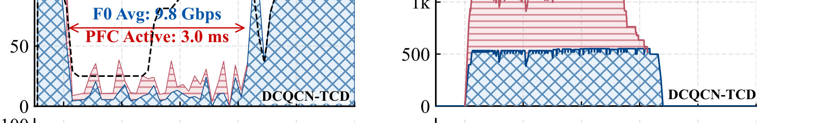
MOTIVATION
Pathology 3: CC can be sidelined by flow control
DCQCN-TCD keeps the F0 sending rate high…
…but PFC still limits the actual F0 throughput.
High CC rate
≠
usable throughput
When the shared queue is paused, congestion control cannot use the bandwidth for the victim flow even if its target rate is high.
Hu et al., Congestion Quarantine in Lossless Ethernet, APNet ’26: Fig. 2 and §2.1 “Congestion control is sidelined by flow control”.
APNet ’26 • Congestion Quarantine
Notes:
The third pathology is CC being sidelined by flow control. TCD identifies victim flows and tries to avoid excessive rate reduction. In Figure 2, DCQCN-TCD keeps F0’s sending rate high. But because the queue is still PFC-paused, actual F0 throughput remains limited.

Slide 10
CORE IDEA
Core idea: quarantine before congestion contagion
Do not let sick and healthy packets wait in the same pause domain.
Before CQ
With CQ
SZ: healthy packets
shared PFC queue
PAUSE applies to all packets
Contagion
QZ: sick packets
Contained
Hu et al., Congestion Quarantine in Lossless Ethernet, APNet ’26: Introduction and §2.3 “The Power of Quarantine”.
APNet ’26 • Congestion Quarantine
Notes:
The root cause is physical coupling of sick and healthy packets in the same PFC-paused queue. CQ breaks this coupling. Sick packets are placed in the quarantine zone, while healthy packets stay in the safe zone. PFC may still act on the quarantine zone, but the safe zone can continue to move.

Slide 11
DESIGN
Design: CP detects, QP quarantines
Quarantine Point (QP)
Congestion Point (CP)
classifier
SZ
packets →
egress
queue
detector
length > Eq
QZ
classifies to SZ / QZ
← release
RR scheduler serves both zones
quarantine / release notification
1 Monitor CP egress queues
2 Trigger if length > Eq
3 QP moves matches into QZ
4 Release if length < Er
Simulation thresholds in the paper: Eq = 200 KB, Er = 100 KB.
Hu et al., Congestion Quarantine in Lossless Ethernet, APNet ’26: Fig. 4 and §3 Congestion Quarantine.
APNet ’26 • Congestion Quarantine
Notes:
CQ has two roles. The congestion point monitors its egress queues and makes the quarantine decision. The upstream quarantine point receives the decision and moves matching packets into QZ. Safe packets remain in SZ. CQ uses round-robin scheduling between zones, so quarantined traffic still receives service.

Slide 12
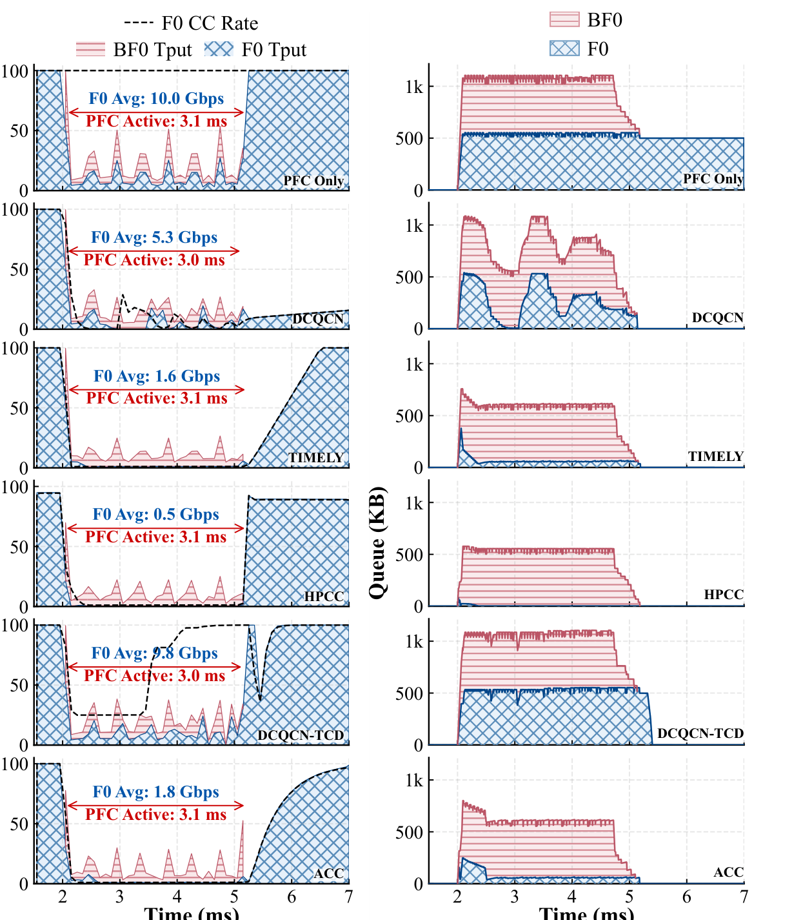
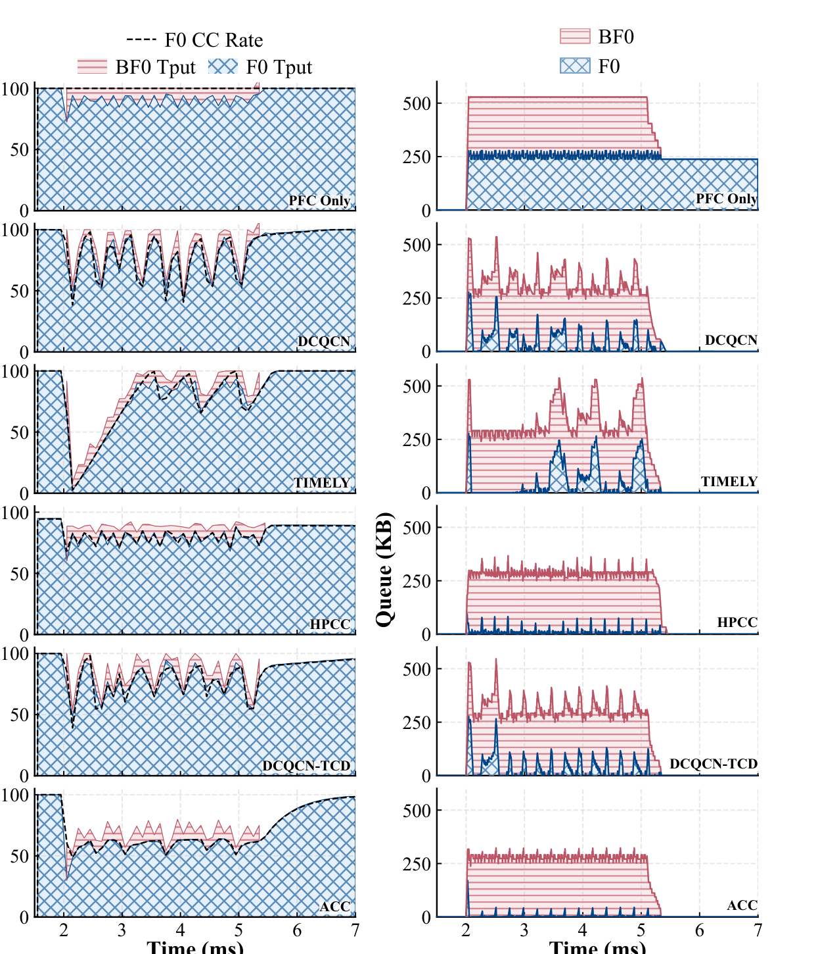
EVALUATION
Micro evaluation: CQ removes the observed pathologies
Without CQ
With CQ
Congestion contagion is confined to QZ
CC no longer trades F0 protection against queue buildup
F0 throughput recovers across evaluated algorithms
CQ decouples burst and victim traffic; PFC acts only on QZ.
APNet ’26 • Congestion Quarantine
Notes:
Figure 2 shows the behavior without CQ; Figure 3 shows the same experiment with CQ. With CQ, burst traffic is quarantined. F0 stays in the safe zone and maintains high throughput. The CC dilemma is removed because rate control no longer has to use one shared queue to represent two different congestion states.

Slide 13
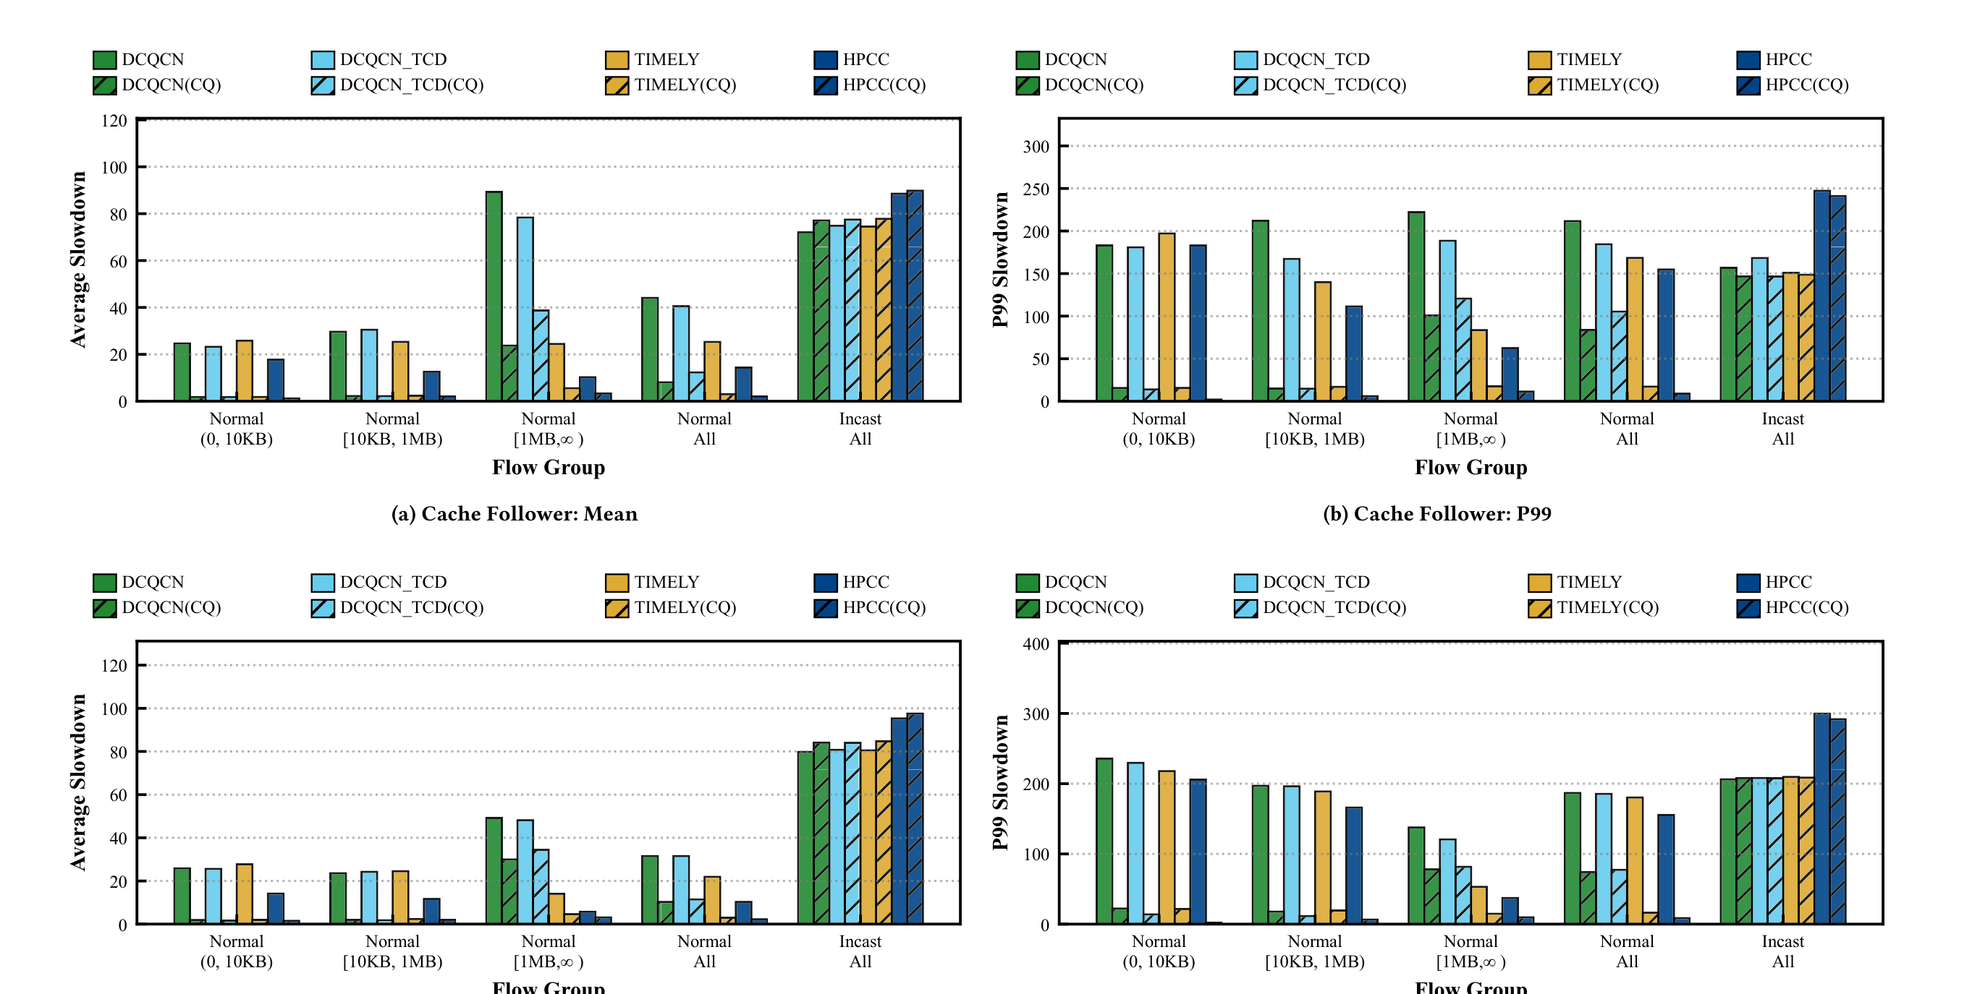
EVALUATION
At scale, CQ cuts normal-flow FCT slowdown
Large-scale setup
320-server Fat-Tree
100G server-to-ToR links
400G inter-switch links
Cache Follower / Web Search + incast
PFC enabled by default
Mean FCT slowdown
25–86% lower
P99 FCT slowdown
33.4–90% lower
Incast stays close
to the baseline
Hu et al., Congestion Quarantine in Lossless Ethernet, APNet ’26: Fig. 7 and §4.2.
APNet ’26 • Congestion Quarantine
Notes:
In large-scale simulations, CQ improves normal flow completion time. Across the evaluated CC algorithms, the average slowdown of normal flows is reduced by 25 to 86 percent, and P99 slowdown is reduced by 33.4 to 90 percent. Incast performance remains close to the baseline because QZ still receives service by round-robin scheduling.

Slide 14
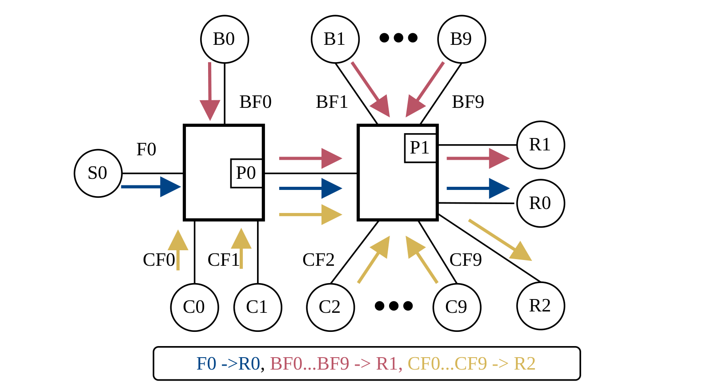
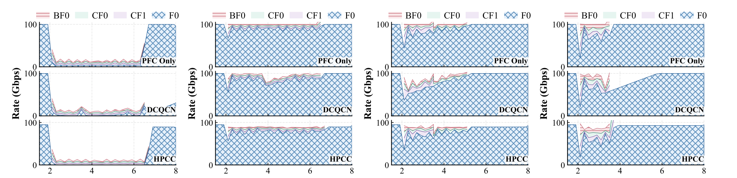
Evaluation: is one Quarantine Queue(QQ) queue enough?
Multi-Trees scenario
Congestion tree BF0–BF9: incast bursts to R1
Congestion tree CF0–CF9: incast bursts to R2
Healthy flow F0: a long-lived flow to R0
QQ assignment in port P0
One shared QQ
One QQ per congestion tree
One QQ per sick flow.
Result: one QQ is enough
Notes:
The paper also tests whether CQ needs multiple quarantine queues. In this multi-tree case, one shared QZ gives performance close to one queue per tree and one queue per sick flow. This supports a practical design with limited extra queue resources.

Slide 15
TAKEAWAYS
Conclusion
Problem: PFC prevents drops, but makes congestion contagious and constrains 起效 of CC.
Design: CQ uses CP decisions to quarantine sick packets at the upstream QP, separating QZ and SZ before backpressure spreads.
Evaluation: CQ removes the micro-scale pathologies and reduces normal-flow mean/P99 FCT slowdown by 25–86% / 33.4–90% at scale.
Thank you
Questions?
APNet ’26 • Congestion Quarantine
Notes:
To summarize: PFC prevents drops, but it makes congestion contagious; congestion control alone cannot break the coupling caused by PFC. CQ detects congestion at the CP and quarantines matching packets at the QP. The evaluation shows that CQ removes the observed symptoms and improves normal-flow FCT at scale. Thank you.

